Slide 1
Chapter 12
Process Techniques

Slide 2
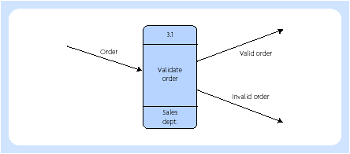
Data flow diagramming
Process box and data flows

Slide 3
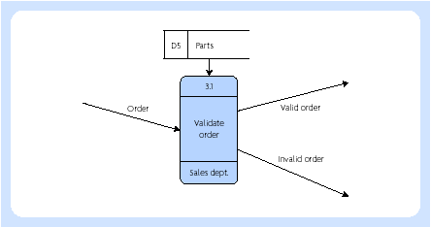
Data flow diagramming
Parts data store

Slide 4
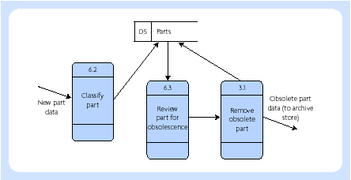
Data flow diagramming
Maintenance of parts data store

Slide 5
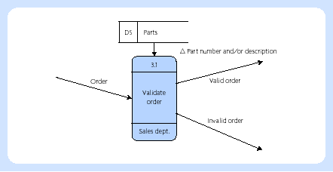
Data flow diagramming
Access to data store

Slide 6
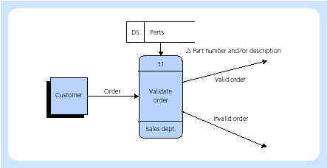
Data flow diagramming
External entity customer (source of order)

Slide 7
Data flow diagramming (Mason & Willcocks, 1994)
• read the whole process a few times to get a clear picture of the system being described
• identify the sources and sinks by circling a keyword for each of them
• identify data stores (perhaps through the use of verbs such as ‘store’ or ‘check’ and underline them)
• draw a source entity box for the external entity which seems to start the process off and name it (entities can only link with processes)
• to its right, draw the first process box
• from that, draw an arrow representing the primary data flow and name it
• name the process
• link it with any data stores and name these as well as the data flow entering or exiting it to and from the process (data cannot go from store to store, there must be an intervening process)
• link the next process and so on until all the external entities are drawn

Slide 8
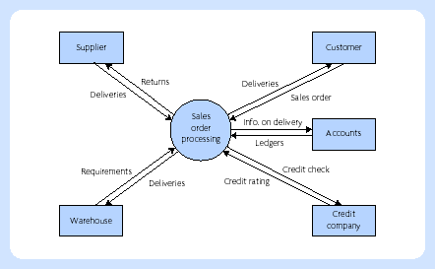
Data flow diagramming
Context diagram

Slide 9
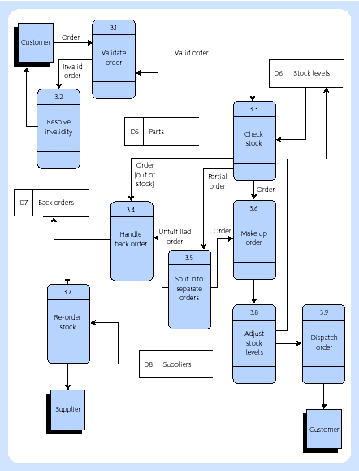
Data flow diagramming
Level 1 diagram for Order Handling

Slide 10
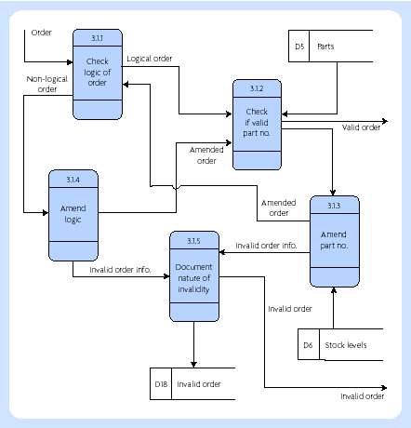
Data flow diagramming
Lower level of detail for ‘validate order’
(Reference 3.1)

Slide 11
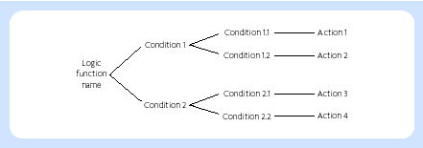
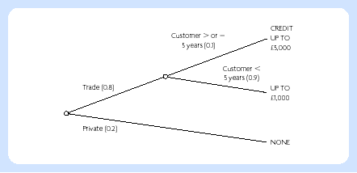
Decision trees

Slide 12
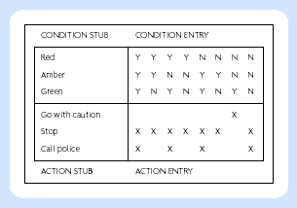
Decision tables
Decision table for UK traffic lights

Slide 13
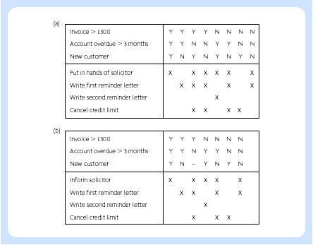
Decision tables
Consolidating decision tables

Slide 14
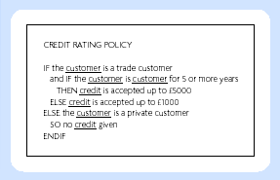
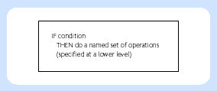
Structured English
Structured English
example
IF . . . THEN
construct

Slide 15
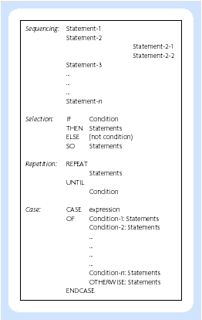
Structured English
The basic structures
of structured english

Slide 16
Structured English
• sequencing shows the order of processing of a group of instructions, but has no repetition or branching built into it
• selection facilitates the choice of those conditions where a particular action or set of actions (or another decision and selection) are to be carried out
• cases represent a special type of decision structure (a special kind of selection), where there are several possibilities, but they never occur in combination (in other words, they are mutually exclusive)
• repetition or loop instructions facilitate the same action or set of actions to be carried out a number of times, depending on a conditional statement

Slide 17
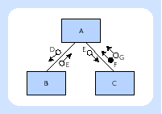
Structure diagrams
• Module A can call module B and also module C. This is shown by lines joining the boxes, which represent modules. No sequencing for these calls nor whether they actually occur is implied by the diagramming notation. When the subordinate process terminates, control goes back to the calling process.
• When A calls B, it sends data of type D to B. When B terminates, it returns data of type E to A. Similarly, A communicates with C using data of types E and G.
• When C terminates, it sends a flag of type F to A. A flag is used as a flow of control data. The difference in the symbol between data types and flags lies in the circle being filled in or not.

Slide 18
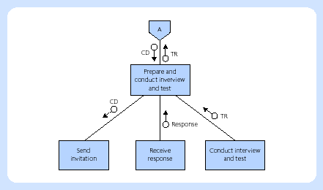
Structure diagrams
Structure diagram for interviewing and testing applications

Slide 19
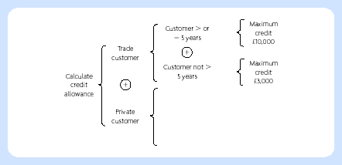
Structure diagrams
Warnier–Orr diagram

Slide 20
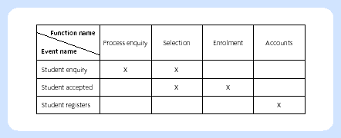
Matrices
Function/event matrix

Slide 21
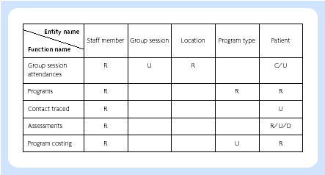
Matrices
Entity/function matrix (CRUD matrix)

Slide 22
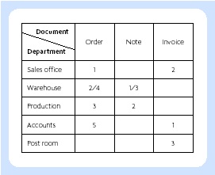
Matrices
Document/department matrix

Slide 23
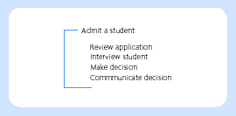
Action diagram

Slide 24
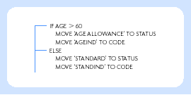
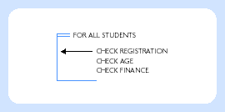
Action diagrams
Selection and case
in action diagrams
Repetition in
action diagrams

Slide 25
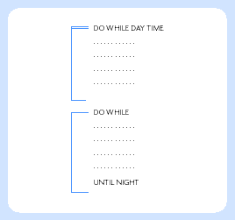
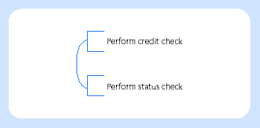
Action diagrams
Process action block
Action diagram concurrency

Slide 26
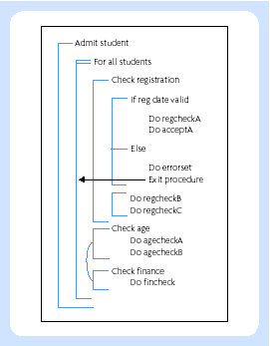
Action diagrams
Action diagram with
a number of constructs

Slide 27
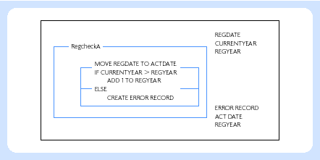
Action diagrams
Action diagram including inputs and outputs

Slide 28
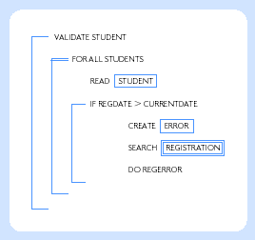
Action diagrams
Action diagram incorporating
database operations

Slide 29
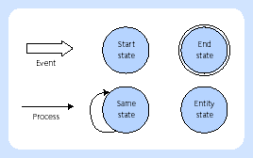
Entity life cycle
Entity life cycle symbols

Slide 30
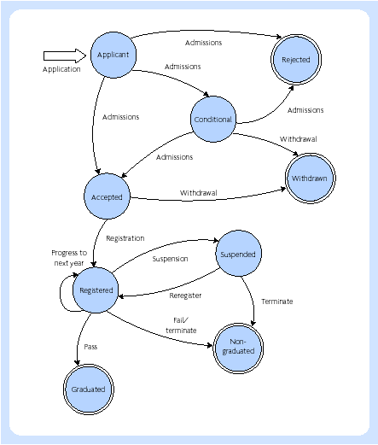
Entity life cycle
Entity life cycle for
the entity student

Slide 31
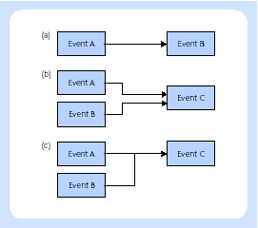
Entity lifecycle
Dependencies between events

